Slide 1
Objectives
In this session, you will learn to:
  Identify the features of .NET Framework
Notes:
Start the session by sharing the session objectives with the students.

Slide 2

Identifying the Features of .NET Framework
What is .NET Framework?

Slide 3

Identifying the Features of .NET Framework (Contd.)
.NET Framework is an integrated technology that helps in creating and running robust, scalable, and distributed applications.

Slide 4
Identifying the Features of .NET Framework (Contd.)
Microsoft introduced the .NET Framework to enhance the interoperability of applications.
The .NET Framework is designed to make improvements in:
  Code reuse
  Code specialization
  Resource management
  Multilanguage development
  Security
  Deployment
  Administration
Notes:
Start the session by sharing the session objectives with the students.

Slide 5
Identifying the Features of .NET Framework (Contd.)
.NET Framework offers a complete suite for developing and deploying applications.
The suit consists of:
  .NET Products
  .NET Services
  .NET Framework
Notes:
Start the session by sharing the session objectives with the students.

Slide 6



Components of the .NET Framework
The following figure shows the different components of the .NET Framework.
CLR is the environment in which all programs that use .NET technologies are executed.
The CLR allows the execution of code across different platforms by translating code into Intermediate Language (IL).
At the presentation layer, .NET provides three types of user interfaces. They are Windows Forms, Web Forms, and Console Applications.
The .NET Framework class library works with any .NET language, such as VB.NET, VC++ .NET, and VC#.
The .NET Framework class library comprises namespaces, which are contained within assemblies.
Notes:
Using this slide, discuss with the students that .NET Framework consists of 3 different components. Discuss each of the components one by one. Try to give an example of the components.

Slide 7
Components of the .NET Framework (Contd.)
Identifying the process of compilation:
  Compilation is the process of creating an executable program from the source code. It converts source code into machine language.
  In .NET, the conversion of source code to machine language takes place in two stages:
    In the first stage, the compiler translates code into an IL instead of machine language or assembly language.
    In the second stage, the JIT compiler converts IL into machine language at run time.
Notes:
Start the session by sharing the session objectives with the students.

Slide 8
Components of the .NET Framework (Contd.)
The following figure shows the process of code compilation.
IL
+
Metadata
Program Code
Compiler
JIT Compiler
Machine Code
Assembly
Notes:
Start the session by sharing the session objectives with the students.

Slide 9
Components of the .NET Framework (Contd.)
Identifying the process of code execution:
  During execution, CLR performs the following steps:
    Loading assemblies and identifying namespaces
    JIT compilation
    Garbage collection
Notes:
Start the session by sharing the session objectives with the students.

Slide 10
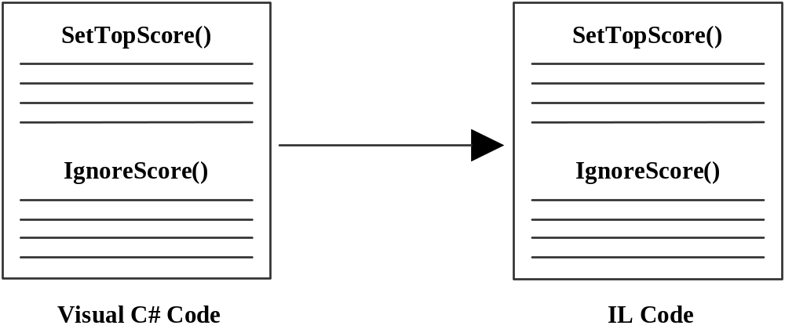
Components of the .NET Framework (Contd.)
The following figure shows the process of code compilation.
Notes:
Start the session by sharing the session objectives with the students.

Slide 11
Components of the .NET Framework (Contd.)
The following figure shows the process of code execution.
SetTopScore()
SetTopScore()
JIT
IgnoreScore()
SetTopScore()
is invoked
IL Code
Machine Language
Notes:
Start the session by sharing the session objectives with the students.

Slide 12
Components of the .NET Framework (Contd.)
The following advantages are offered by the .NET Framework:
  Consistent programming model: The .NET Framework provides a common object-oriented programming model across languages.
  Multi-platform applications: A .NET application can be executed on any platform and architecture supported by CLR.
  Multi-language integration: .The NET Framework allows integration of multiple languages. You can create a VC# class deriving from a VB.NET class.
  Automatic resource management: The CLR tracks resource usage and relieves a programmer from the task of manual resource management.
  Ease of deployment: .NET applications can be deployed simply by copying files to the target computer.
Notes:
Using this slide discuss the advantages of .NET framework

Slide 13
Summary
In this session, you learned that:
  .NET Framework is made up of many components, such as CLS, CLR, and JIT compiler.
  The CLR is the environment where all .NET applications are executed.
  CLS is a set of rules that are followed by all the languages of the .NET Framework.
  When a program is compiled by using Visual Studio, the compiler translates the code into IL instead of machine language.
  The JIT compiler is used to translate the code from IL into machine language.
Notes:
You can summarize the session by using the summary given in the slides.
In addition, you can also ask students summarize what they have learnt in this session.

